Slide 2
Java Collections

Slide 3
The Collection in Java is a framework that provides an architecture to store and manipulate the group of objects.
Java Collections can achieve all the operations that you perform on a data such as searching, sorting, insertion, manipulation, and deletion.
Java Collection means a single unit of objects. Java Collection framework provides many interfaces (Set, List, Queue, Deque) and classes (ArrayList, Vector, LinkedList, PriorityQueue, HashSet, LinkedHashSet, TreeSet).

Slide 4
What is Collection in Java
A Collection represents a single unit of objects, i.e., a group.
What is a framework in Java
It provides readymade architecture.
It represents a set of classes and interfaces.
It is optional.
What is Collection framework
The Collection framework represents a unified architecture for storing and manipulating a group of objects. It has:
Interfaces and its implementations, i.e., classes
Algorithm

Slide 5
Unified architecture for representing and manipulating collections.
A collections framework contains three things
Interfaces
Implementations
Algorithms

Slide 6
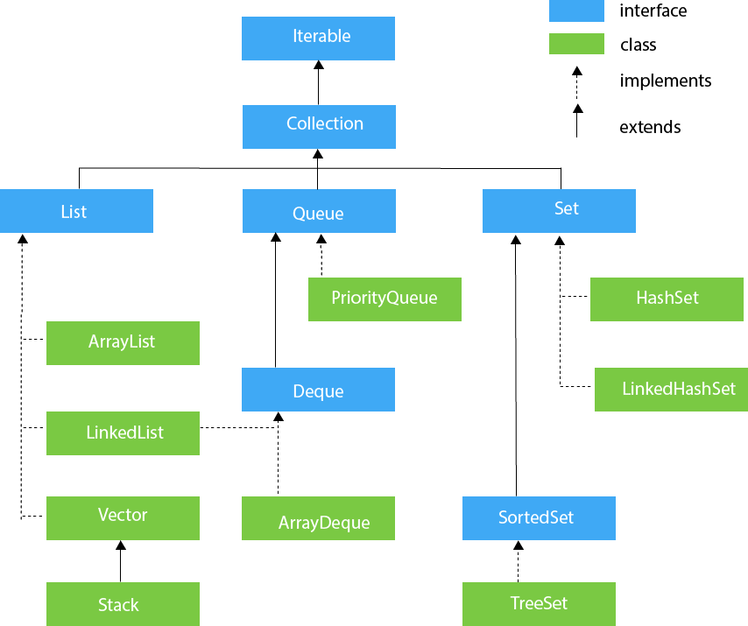

Slide 7
ArrayList | Vector
ArrayList is cannot be synchronized. | Vector can be is synchronized.
It is not a legacy class. | It is a legacy class.
It can increase its size by 50% of the size of the array. | It can increase its size by doubling the size of the array.
ArrayList is not thread-safe. | Vector is a thread-safe
ArrayList | LinkedList
It uses a dynamic array. | It uses a doubly-linked list.
ArrayList is not preferable for manipulation. | LinkedList is preferable for manipulation.
ArrayList provides random access. | LinkedList does not provide random access.
ArrayList s stores only objects hence it takes less overhead of memory | LinkedList stores object as well as address object; hence, it takes more overhead of memory.

Slide 8
Iterator | ListIterator
The Iterator can traverse the array elements in the forward direction. | ListIterator can traverse the array elements in backward as well as forward directions.
It can be used in Queue, List, and Set. | It can be used in List.
It can perform only remove operation. | It can perform add, remove, and set operation while traversing the collection.
Iterator | Enumeration
The Iterator can traverse both legacies as well as non-legacy elements. | Enumeration can traverse only legacy elements.
The Iterator is fail-fast. | Enumeration is not fail-fast.
The Iterator is very slow compare to Enumeration. | Enumeration is fast compare to Iterator.
The Iterator can perform remove operation while traversing the collection. | The Enumeration can perform only traverse operation on the collection.

Slide 9
Comparable | Comparator
Comparable provides compareTo() method to sort elements in Java. | Comparator provides compare() method to sort elements in Java.
Comparable interface is present in java.lang package. | Comparator interface is present in java. util package.
The logic of sorting must be in the same class whose object you are going to sort. | The logic of sorting should be in a separate class to write different sorting based on different attributes of objects.
The class whose objects you want to sort must implement the comparable interface. | Class, whose objects you want to sort, do not need to implement a comparator interface.
It provides single sorting sequences. | It provides multiple sorting sequences.
This method can sort the data according to the natural sorting order. | This method sorts the data according to the customized sorting order.
It affects the original class. i.e., the actual class is altered. | It doesn't affect the original class, i.e., the actual class is not altered.
Implemented frequently in the API by Calendar, Wrapper classes, Date, and String. | It is implemented to sort instances of third-party classes.
All wrapper classes and String class implement the comparable interface. | The only implemented classes of Comparator are Collator and RuleBasedColator.

Slide 10
List | Set
An ordered collection of elements | An unordered collection of elements
Preserves the insertion order | Doesn't preserves the insertion order
Duplicate values are allowed | Duplicate values are not allowed
Any number of null values can be stored | Only one null values can be stored
ListIterator can be used to traverse the List in any direction | ListIterator cannot be used to traverse a Set
Contains a legacy class called vector | Doesn't contains any legacy class

Slide 11
Hashmap | Hashtable
It is not synchronized. | It is synchronized.
HashMap allows one key as a null value. | HashTable does not allow null values.
Iterator is used to traverse HashMap. | Either Iterator or Enumerator is used for traversing a HashTable.
It can be used for both HashTable, HashMap and is fail-fast. | It can be used with HashTable and is fail-safe.
HashMap perform faster than the HashTable. | Hashtable is not much faster as compared to HashMap.

